Slide 1

1D Rydberg atom arrays: An entry point to studying out of equilibrium dynamics of isolated quantum many body systems
Oliver Lind

Slide 2
Motivation
Classical Isolated System
Adiabatic walls (no transfer of heat outwards)
Balloon has N particles with total energy E
Rest of the chamber is a vacuum
Vacuum

Slide 3
Motivation
Classical Isolated System
Adiabatic walls (no transfer of heat outwards)
Balloon has N particles with total energy E
Rest of the chamber is a vacuum
Peirce the balloon

Slide 4
Motivation
Classical Isolated System
Adiabatic walls (no transfer of heat outwards)
Balloon has N particles with total energy E
Rest of the chamber is a vacuum
Peirce the balloon
Air particles spread

Slide 5
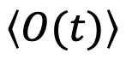
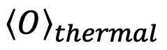
Motivation
Classical Isolated System
Adiabatic walls (no transfer of heat outwards)
Balloon has N particles with total energy E
Rest of the chamber is a vacuum
Peirce the balloon
Air particles spread
System thermalizes
Macroscopic observables reach steady average value:
$$\left\langle O(t)\right\rangle$$
$${\left\langle O\right\rangle }_{thermal}$$

Slide 6
Motivation
Classical Isolated System
Adiabatic walls (no transfer of heat outwards)
Balloon has N particles with total energy E
Rest of the chamber is a vacuum
Peirce the balloon
Air particles spread
System thermalizes
Macroscopic observables reach steady average value:
$$\left\langle O(t)\right\rangle$$
$${\left\langle O\right\rangle }_{thermal}$$

Slide 7
Motivation
Classical Isolated System
Adiabatic walls (no transfer of heat outwards)
Balloon has N particles with total energy E
Rest of the chamber is a vacuum
Peirce the balloon
Air particles spread
System thermalizes
Macroscopic observables reach steady average value:
$$\left\langle O(t)\right\rangle$$
$${\left\langle O\right\rangle }_{thermal}$$

Slide 8
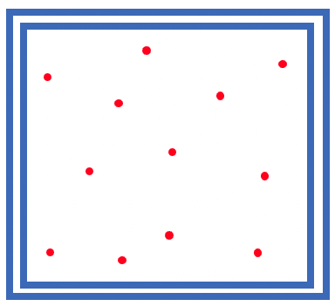
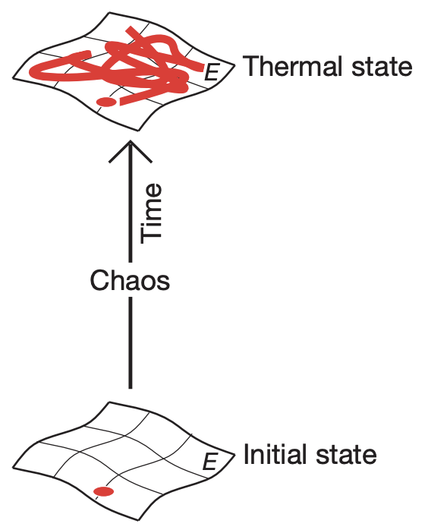



Motivation
Statistical Physics
What happens in an isolated quantum system?
Unitary time evolution
Discrete energy levels
Heinsberg's uncertainty principle
Maximum Entropy
Can the system thermalize in the same way?
Can we associate entropy in the same way?
Are there global properties that can help us understand this?
Low Entropy

Slide 9
Motivation
Statistical Physics
What happens in an isolated quantum system?
Unitary time evolution
Discrete energy levels
Heinsberg's uncertainty principle
Maximum Entropy
Studying out of equilibrium dynamics of isolated quantum systems
1D Rydberg atom arrays quantum simulators
Entry point
Can the system thermalize in the same way?
Can we associate entropy in the same way?
Are there global properties that can help us understand this?
Low Entropy

Slide 10
Contents
Introduce the model
Rydberg Atoms
Rydberg Blockade
Ising Type Hamiltonian
Forming Crystals
Bringing the system out of equilibrium
Entanglement entropy
Relate the two

Slide 11
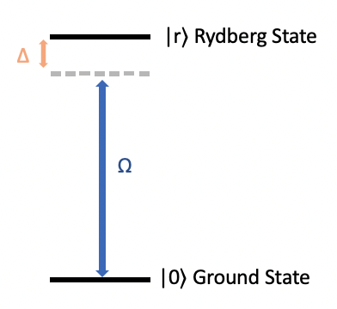
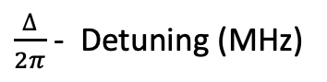
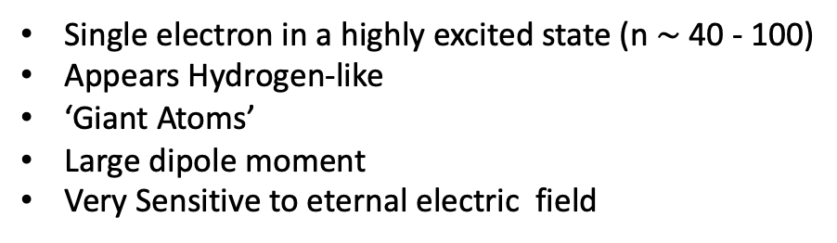
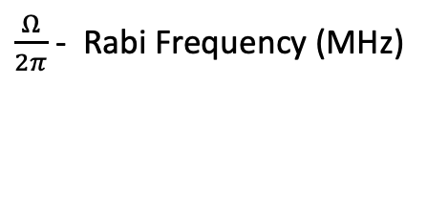
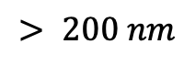
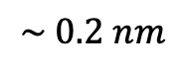
Rydberg Atoms: What are they?
Encoding as a qubit
Single electron in a highly excited state (n $\sim$40 - 100)
Appears Hydrogen-like
‘Giant Atoms’
Large dipole moment
Very Sensitive to eternal electric field
Driving Laser
+
$\frac{Ω}{2π}$ - Rabi Frequency (MHz)
$\frac{∆}{2π}$ - Detuning (MHz)
Size
$$\sim 0.2 nm$$
$$> 200 nm$$

Slide 12
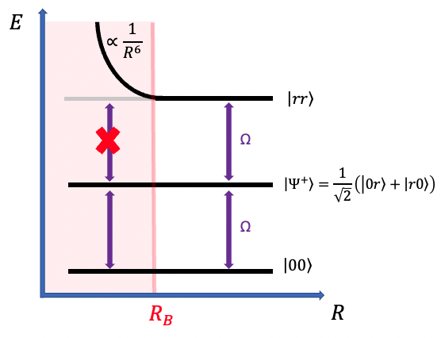
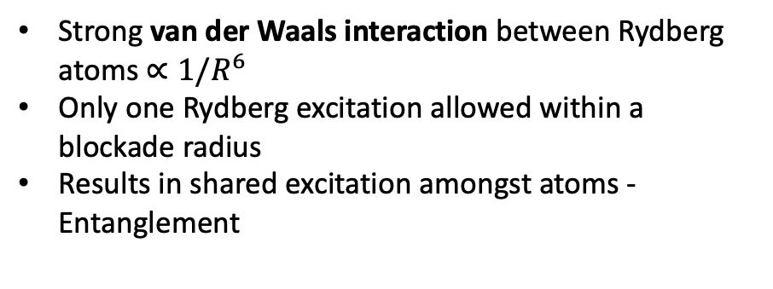
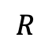
Interaction and Rydberg Blockade
Strong van der Waals interaction between Rydberg atoms $∝1/R^{6}$
Only one Rydberg excitation allowed within a blockade radius
Results in shared excitation amongst atoms - Entanglement
$$R$$

Slide 13
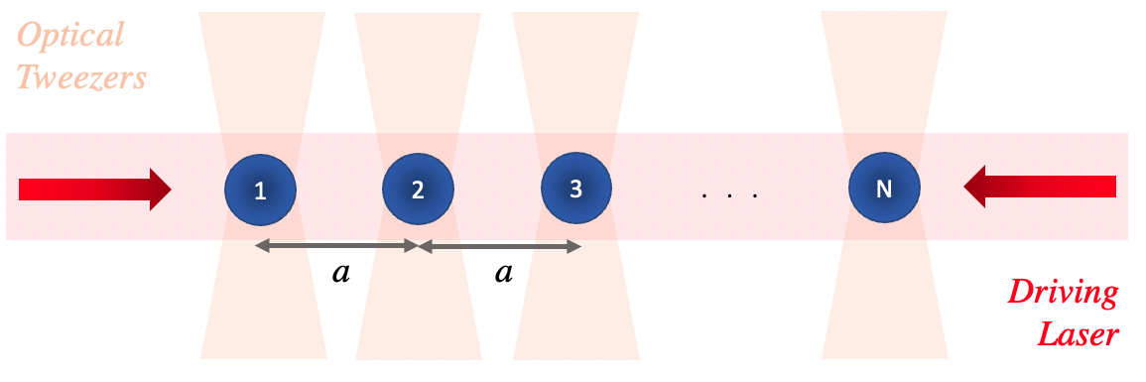
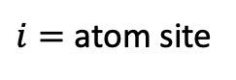
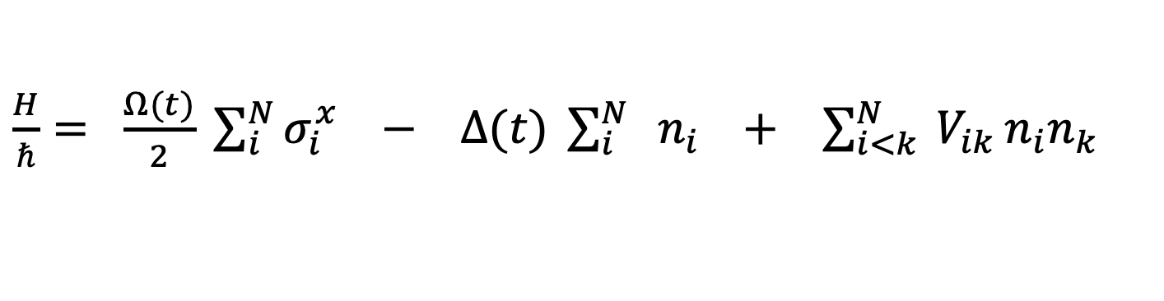
Many Body Hamiltonian
$\frac{H}{ℏ}= \frac{Ω(t)}{2} \sum_{i}^{N}{σ_{i}^{x}} −$ $∆(t) \sum_{i}^{N}{ { n}_{i}}$ $+$ $\sum_{i<k}^{N}{ V_{ik}}n_{i}n_{k}$
$i=$ atom site
Driving term
Detuning term
Interaction term

Slide 14
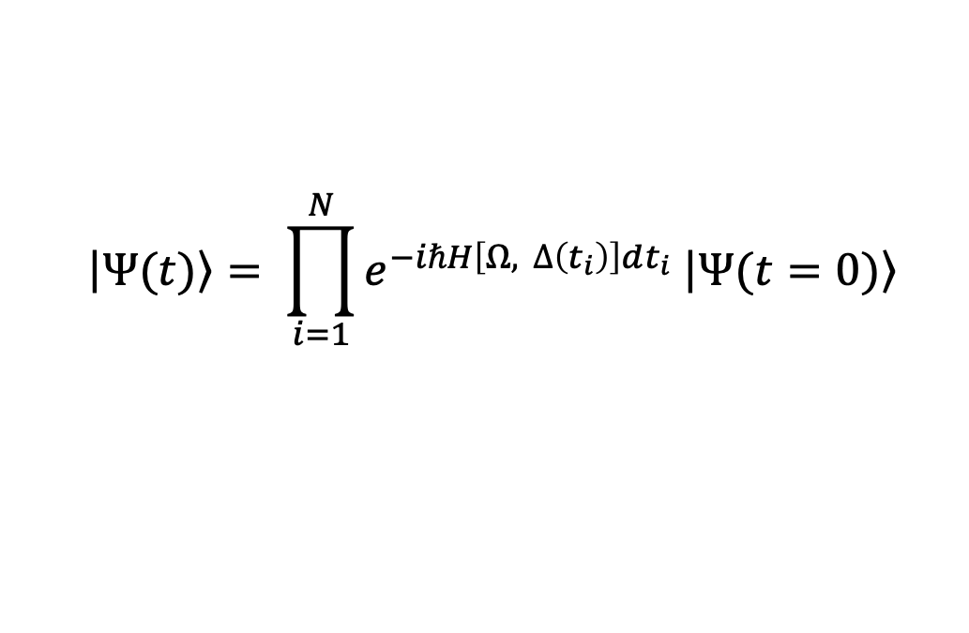
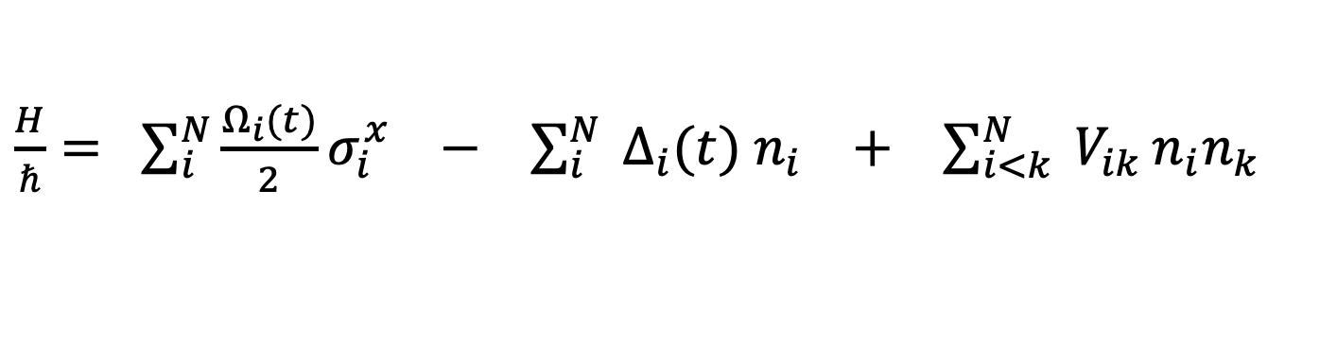
Many Body Hamiltonian: Single site addressing
Evolve the system with Trotter-Suzuki decomposition:
$$\left|\left.Ψ(t)\right\rangle \right.= \prod_{i=1}^{N}{e^{−iℏH\left[Ω, ∆\left(t_{i}\right)\right]dt_{i}} \left|\left.Ψ(t=0)\right\rangle \right.}$$
$\frac{H}{ℏ}= \sum_{i}^{N}{\frac{Ω_{i}(t)}{2}σ_{i}^{x}} −$ $\sum_{i}^{N}{ ∆_{i}(t){ n}_{i}}$ $+$ $\sum_{i<k}^{N}{ V_{ik}}n_{i}n_{k}$
$i=$ atom site
Driving term
Detuning term
Interaction term

Slide 15
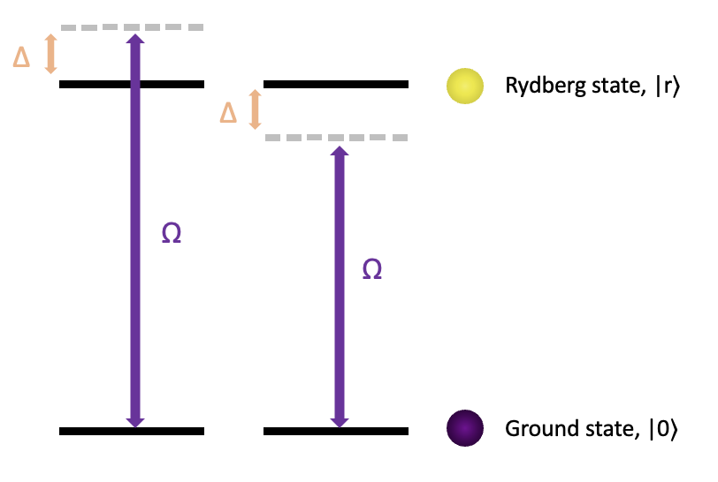
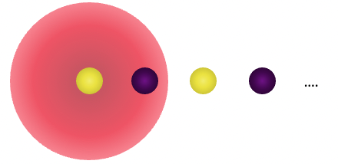
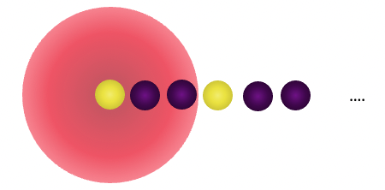
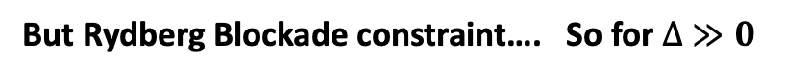
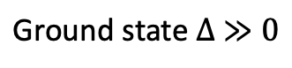
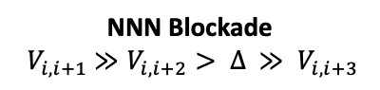
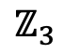
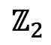
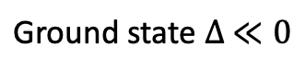
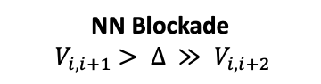
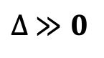
Using blockade to generate ordered states
$$\text{Ground} \text{state} ∆ ≪0$$
$$\text{Ground} \text{state} ∆ ≫0$$
But Rydberg Blockade constraint…. So for $∆ ≫0$
$$ℤ_{2}$$
$$ℤ_{3}$$
NN Blockade
$${ V}_{i, i+1} > ∆ ≫ V_{i, i+2}$$
NNN Blockade
$${ V}_{i, i+1} ≫V_{i, i+2}> ∆ ≫ V_{i, i+3}$$
Note:
Focus NN Blockade
Odd number of sites (No degeneracy in the ground state)
$∆ ≫0$
Odd GS
Even GS

Slide 16
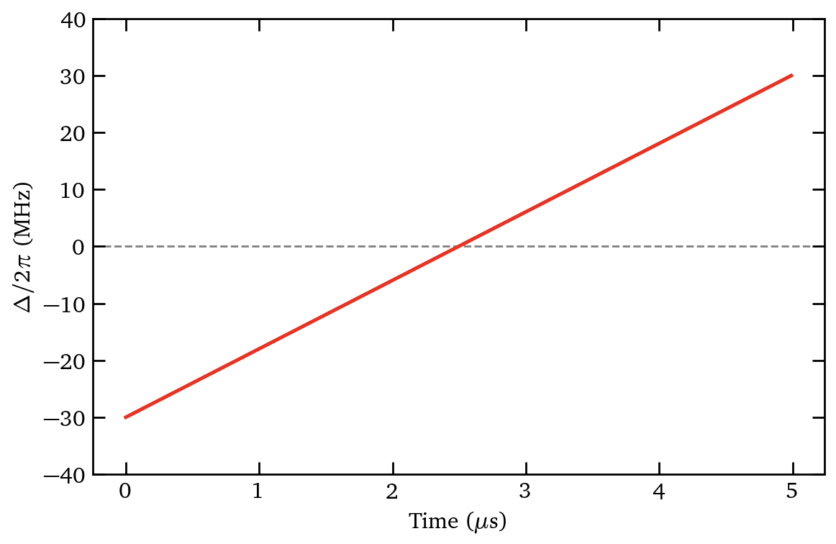
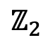


Using blockade to generate ordered states
Focus on 7 atom
$$\text{Ground} \text{state} ∆ ≪0$$
By adjusting the separation between atoms $a$, we can sweep through detuning values to generate desired order states:
$$\text{Ground} \text{state} ∆ ≫0$$
But Rydberg Blockade constraint…. So for $∆ ≫0$
Focus on 7 Atoms
$∆ ≫0$ Ground State
$$ℤ_{2}$$
NN Blockade
$${ V}_{i, i+1} > ∆ ≫ V_{i, i+2}$$
NNN Blockade
$${ V}_{i, i+1} ≫V_{i, i+2}> ∆ ≫ V_{i, i+3}$$
$∆ ≪0$Ground state
Note:
Focus NN Blockade
Odd number of sites (No degeneracy in the ground state)
$∆ ≫0$
Odd GS
Even GS

Slide 17
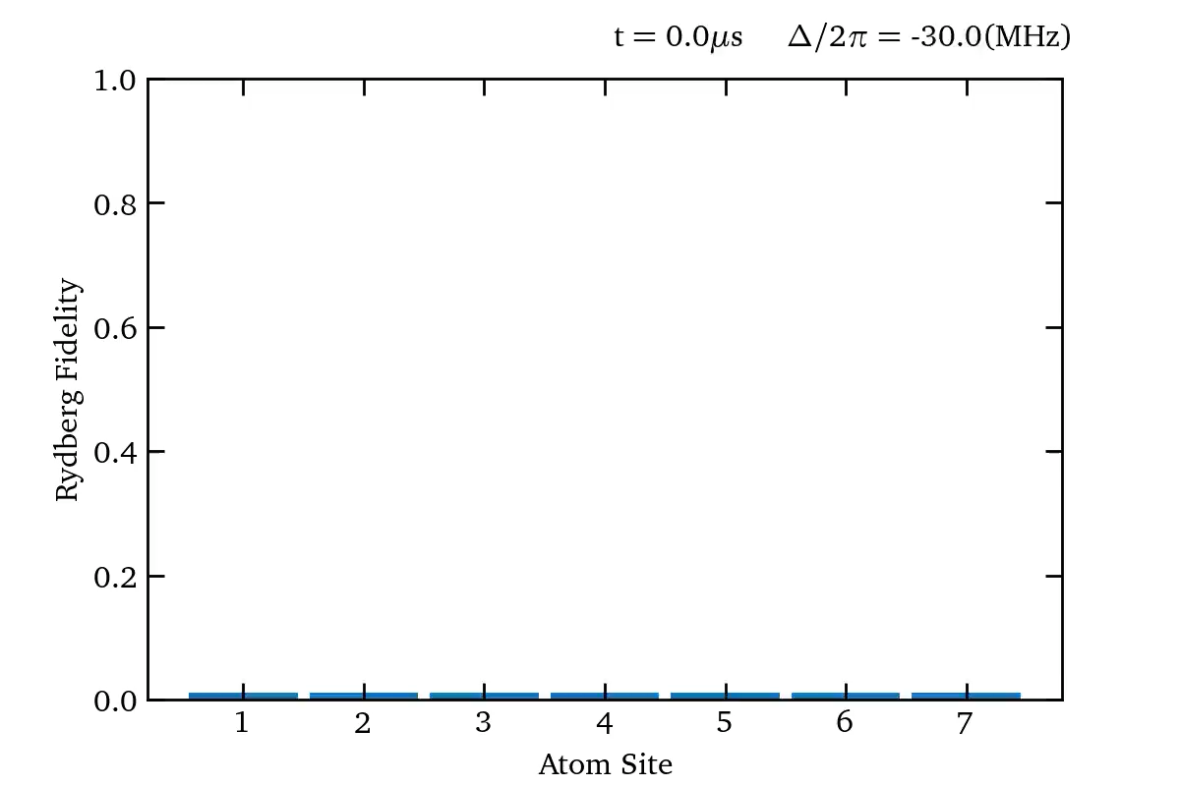
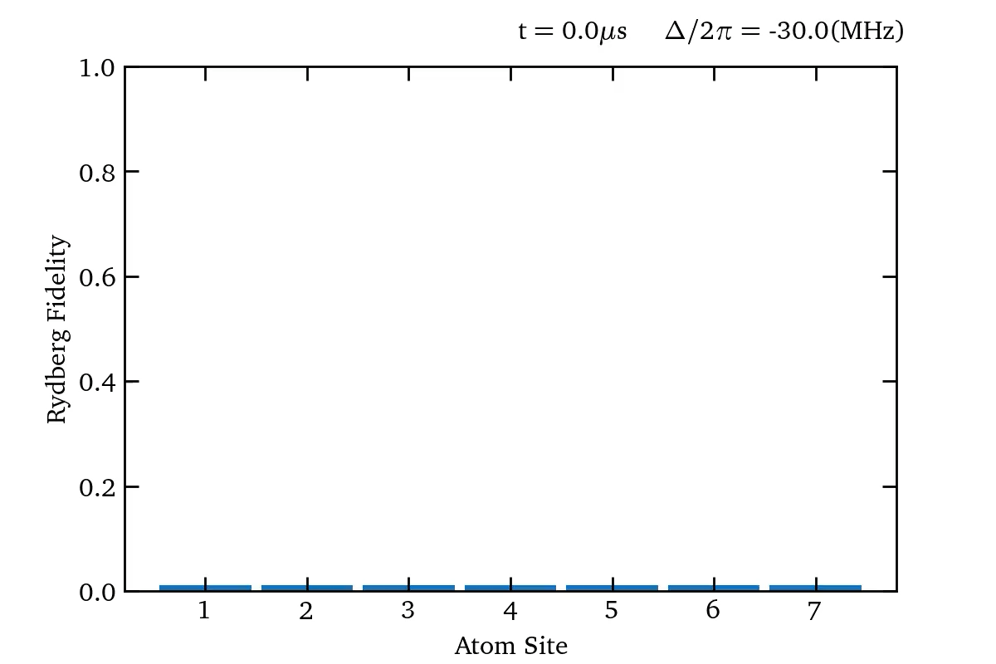
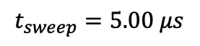
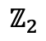
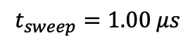
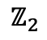
Using blockade to generate ordered states
$$t_{sweep}=5.00 μs$$
$$t_{sweep}=1.00 μs$$
$$ℤ_{2}$$
$$ℤ_{2}$$

Slide 18
Using blockade to generate ordered states
$$t_{sweep}=5.00 μs$$
$$t_{sweep}=1.00 μs$$

Slide 19
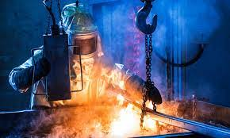
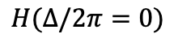
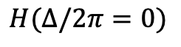
What if we intend on going quickly: quenches
$$ℤ_{2}$$
$$H(∆/2π=0)$$
$$H(∆/2π=0)$$

Slide 20
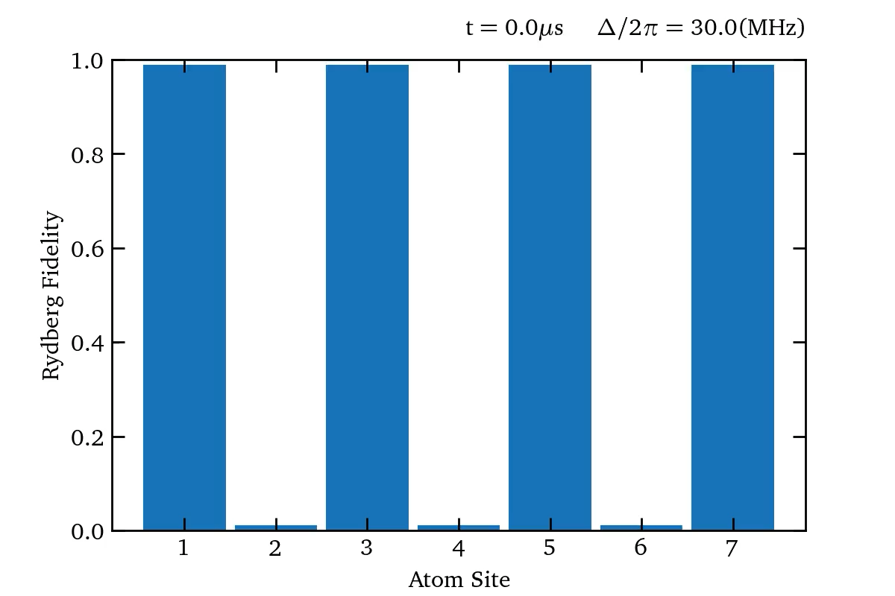
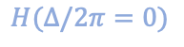
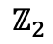
What if we intend on going quickly: quenches
$$ℤ_{2}$$
$$H(∆/2π=0)$$

Slide 21
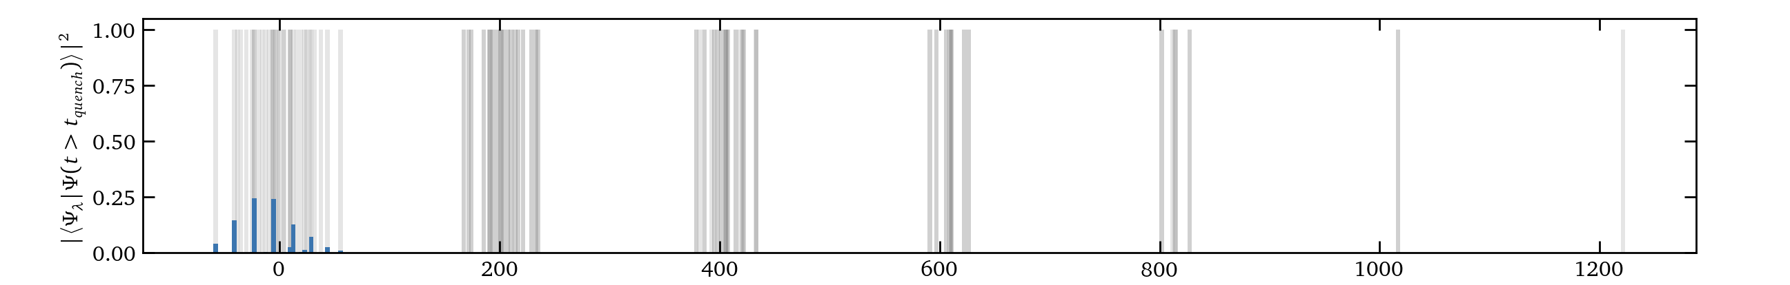
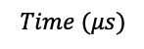
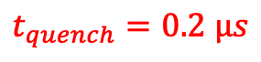
What if we intend on going quickly: quenches
$$Time (μs)$$
$t_{quench}=0.2 μs$

Slide 22
So why is this interesting?

Slide 23
Acknowledgements

Slide 24
Values

Slide 25
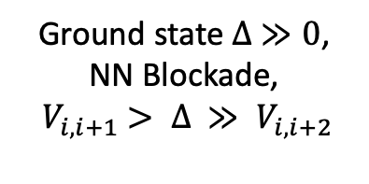
Using Blockade to generate ordered states
$$\text{Ground} \text{state} ∆ ≪0$$
$$\text{Ground} \text{state} ∆ ≫0$$
But Rydberg Blockade constraint….
$\text{Ground} \text{state} ∆ ≫0$,
NN Blockade,
${ V}_{i, i+1} > ∆ ≫ V_{i, i+2}$

Slide 26
Entanglement: can this offer us any further insight?
Entanglement Entropy
3

Slide 27
We then went on to look at…..

Slide 28
New Slide

Slide 29
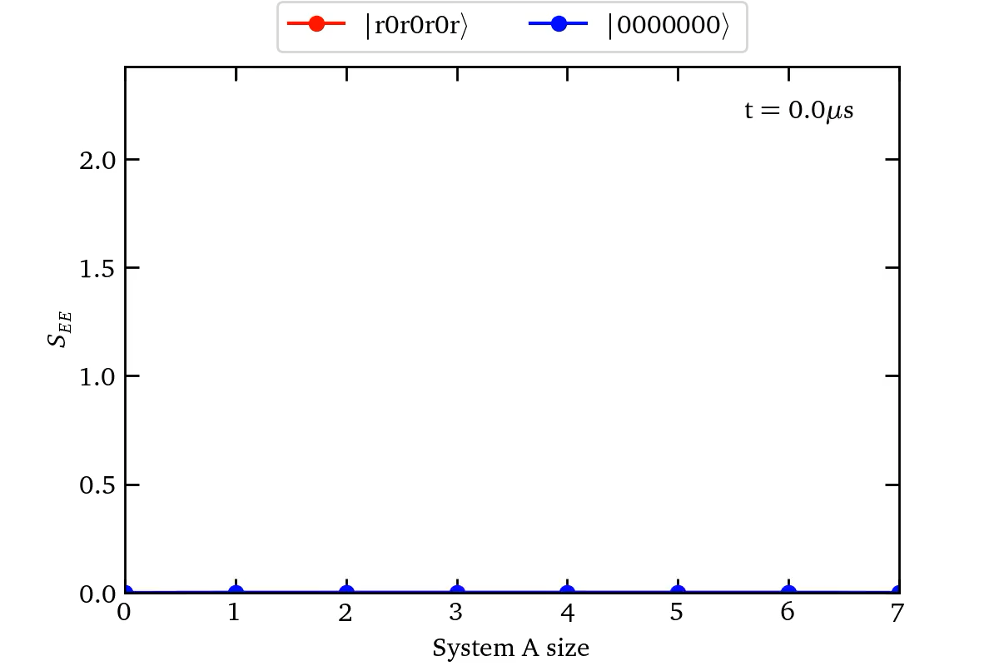
Interaction and Rydberg Blockade

Slide 30


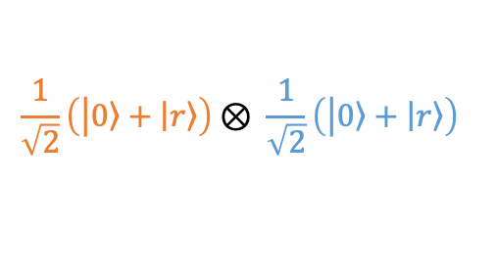
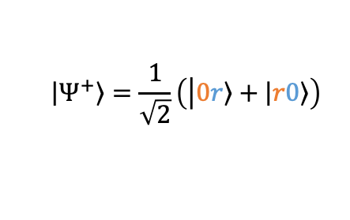
Entanglement: can this offer us any further insight?
Two qubits
Product states
$$\frac{1}{\sqrt{2}}\left(\left|\left.0\right\rangle +\left|\left.r\right\rangle \right.\right.\right)⊗ \frac{1}{\sqrt{2}}\left(\left|\left.0\right\rangle +\left|\left.r\right\rangle \right.\right.\right)$$
Atom 1
Atom 2
Entangled states
$$\left|\left.Ψ^{+}\right\rangle \right.=\frac{1}{\sqrt{2}}\left(\left|\left.0r\right\rangle +\left|\left.r0\right\rangle \right.\right.\right)$$
Need Atom 2 to fully describe the state of atom 1

